Slide 1


Slide 2
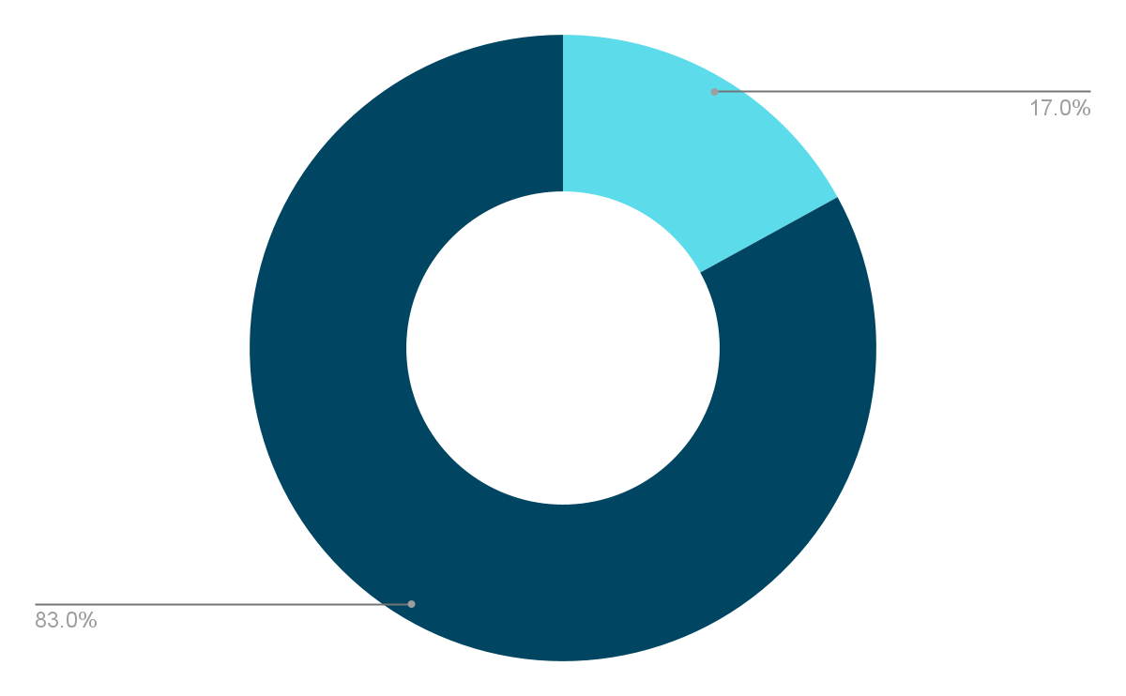
17% of recoveries in child abduction cases are the direct result of AMBER Alerts ¹
AmberAlert.gov

Slide 3
How can we improve?

Slide 4
Relying on human engagement with Alerts is Flawed...
Lack of interest or awareness
Human bias
The general public cannot generate helpful data reliably, efficiently, and in the same volume that an automated system can

Slide 5
Technology is better
Machines are more reliable in time-sensitive, mission critical contexts
Vehicles and vehicle accessories are becoming smarter and faster, with internet connections, GPS, and video capabilities becoming more common.

Slide 6
43% of AMBER Alert success stories resulted from recognizing a vehicle ²
2. National Center for Missing & Exploited Children, 2020 Report

Slide 7
Introducing Electri
Electri enables smart vehicles to automatically assist in finding vehicles marked by AMBER Alerts
Simply Enable the Electri App on your car or dash-cam, and whenever an AMBER Alert is issued in your area, it will automatically begin sending images to our servers, where we use computer vision to see if the image matches the description. Any potential matches are then sent to law enforcement, where they can verify the match and pursue the abductor.

Slide 8
Saving Lives with Zero Human Effort
More information
Image, GPS location, exact time of sighting, broader area coverage
More reliably
Vehicle recognition software and matching
Ease of Use
No necessary human interaction

Slide 9
Privacy and Security
Only necessary information is sent from the cars: GPS, Timestamp, and the Image
No personal information of any kind is recorded, and only relevant matches are stored in our database
It can only be activated by the proper authorities

Slide 10
Electri:
An easy way to save lives

